Slide 1


SAP Full-Stack Developer
Training
ABAP on HANA, UI5 & Fiori, Analytics with OData
Anubhav Oberoy
Day – 6

Slide 2

Agenda – Day 6
Fiori System architecture
Fiori App Ref. Library
SAP Fiori Standard App Implementation
Relationship between Front-End Components
---Break---
What SAP fiori element
Advantage of Fiori Elements
Fiori Element v/s Free style App
Example scenario for Products
Create List Report Fiori Elements App

Slide 3
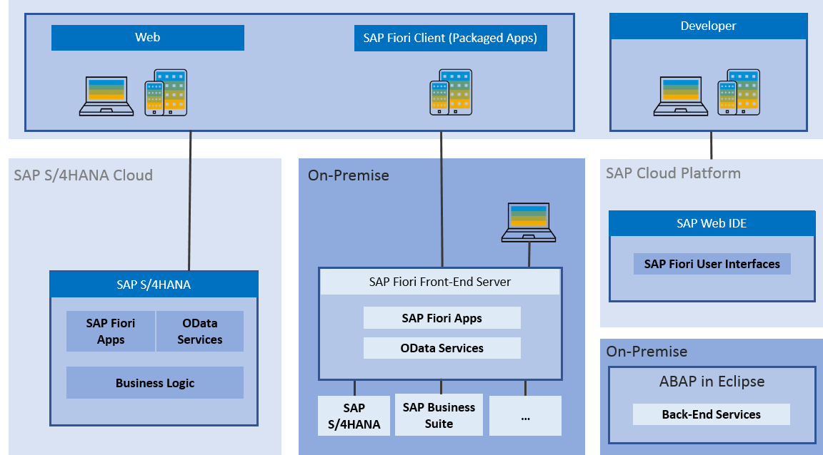
Fiori System Architecture
The SAP Fiori architecture introduces the high-level architecture of SAP Fiori.
The SAP Fiori apps are built with SAPUI5 technology for web applications and iOS native and can be used on smartphones, tablets, and desktop computers.
The SAP Fiori launchpad is used to launch and run the apps.

Slide 4
Fiori App Ref. Library
It’s a library which tells us all the list of Fiori Apps and Non-Fiori Apps offered by SAP as standard.
These apps are grouped under solutions and we can search particular app(s) based on different criteria
https://fioriappslibrary.hana.ondemand.com/sap/fix/externalViewer/
Total Apps – 11628
Fiori Apps - 2107
By Name, description
By User function
By Id & Product
By Functional
Area – Finance, Sales, Marketing, Procurement
By Role
Different Search Criteria

Slide 5
Two types of SAP-Fiori app implementations
Standard Apps
Implementation of those business apps, which are released by SAP
These are categorized as Transnational, Fact-sheets and Analytical apps etc.
Customized Apps
As per business requirement, a complete custom fiori app can be implemented.
Customized App is been hosted on SAP-Fiori server (front-end system).
It integrates with SAP or Non-SAP system.

Slide 6
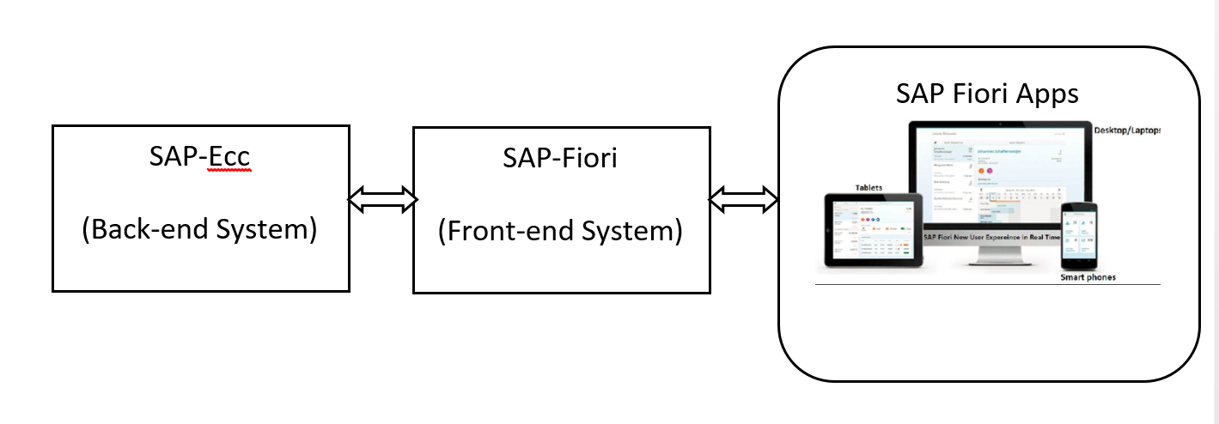
SAP Fiori Standard App Implementation
SAP Fiori is a new user experience (UX) for SAP software and applications.
It provides a set of applications that are used in regular business functions like work approvals, financial apps, calculation apps and various self-service apps.
SAP Fiori Apps can be accessed on desktops, Mobile or tablets.
These are web-based applications hosted on SAP-Fiori server (front-end system) and access business data from SAP-ECC(back-end system).

Slide 7
Pre-requisites for Standard Fiori App
SAP ECC Server (Back-end)
SAP Fiori Server (Front-end)
SAP Fiori Launchpad Url:
1. http://<host>:<port>/sap/bc/ui5_ui5/ui2/ushell/shells/abap/FioriLaunchpad.html
SAP Fiori Designer Url:
http://<host>:<port>/sap/bc/ui5_ui5/sap/arsrvc_upb_admn/main.html
Important T-codes:
SrNo | T-code | Description
1 | SICF (Path: /sap/bc/ui5_ui5/sap/) | UI5 Application Path
2 | SICF (Path: /sap/opu/odata/sap/) | Odata Service Path
3 | /n/iwfnd/maint_service | Odata Service Registration
4 | /n/UI2/SEMOBJ_SAP | Semantic objects by SAP
5 | /n/iwfnd/error_log | Error Log
6 | LPD_CUST | Launchpad Role
7 | PFCG | PFCG Role
Trainer: Anubhav Oberoy

Slide 8

SAP Fiori Custom App development
Customized App is been hosted on SAP-Fiori server (front-end system).
It integrates with SAP or Non-SAP system.
Pre-requisites for Customized Fiori App
SAP or Non-SAP system’s data interchange technique like RFC, webservice etc.
SAP Fiori Launchpad Url:
http://<host>:<port>/sap/bc/ui5_ui5/ui2/ushell/shells/abap/FioriLaunchpad.html
SAP Fiori Designer Url:
http://<host>:<port>/sap/bc/ui5_ui5/sap/arsrvc_upb_admn/main.html
Trainer: Anubhav Oberoy

Slide 9
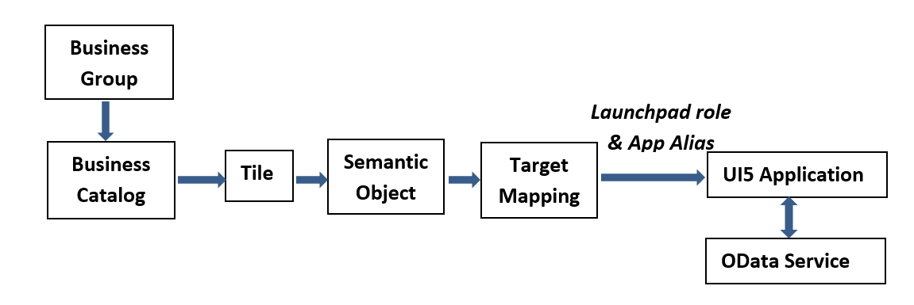
Relationship between Front-End Components
Trainer: Anubhav Oberoy

Slide 10

Break
Trainer: Anubhav Oberoy

Slide 11
SAP Fiori Element
SAP Fiori elements is a framework that comprises the most commonly used floorplan templates and is designed to:
Speed up development by reducing the amount of frontend code needed to build SAP Fiori apps.
Drive UX consistency and compliance with the latest SAP Fiori design guidelines.
Each version of SAP Fiori elements supports a different version of OData (Open Data Protocol), as their names indicate:
SAP Fiori elements for OData version 2 (V2)
SAP Fiori elements for OData version 4 (V4)
Fiori Elements are reusable templates, the main benefit is to:
Reduce the maintenance as there is no need to develop the JS code
Application standardization
Reduce effort in development
Using annotation makes its independent of UI technology
Fiori Apps
Data Source Exposes the OData Service
SEGW Service | CDS View based Service
Trainer: Anubhav Oberoy

Slide 12
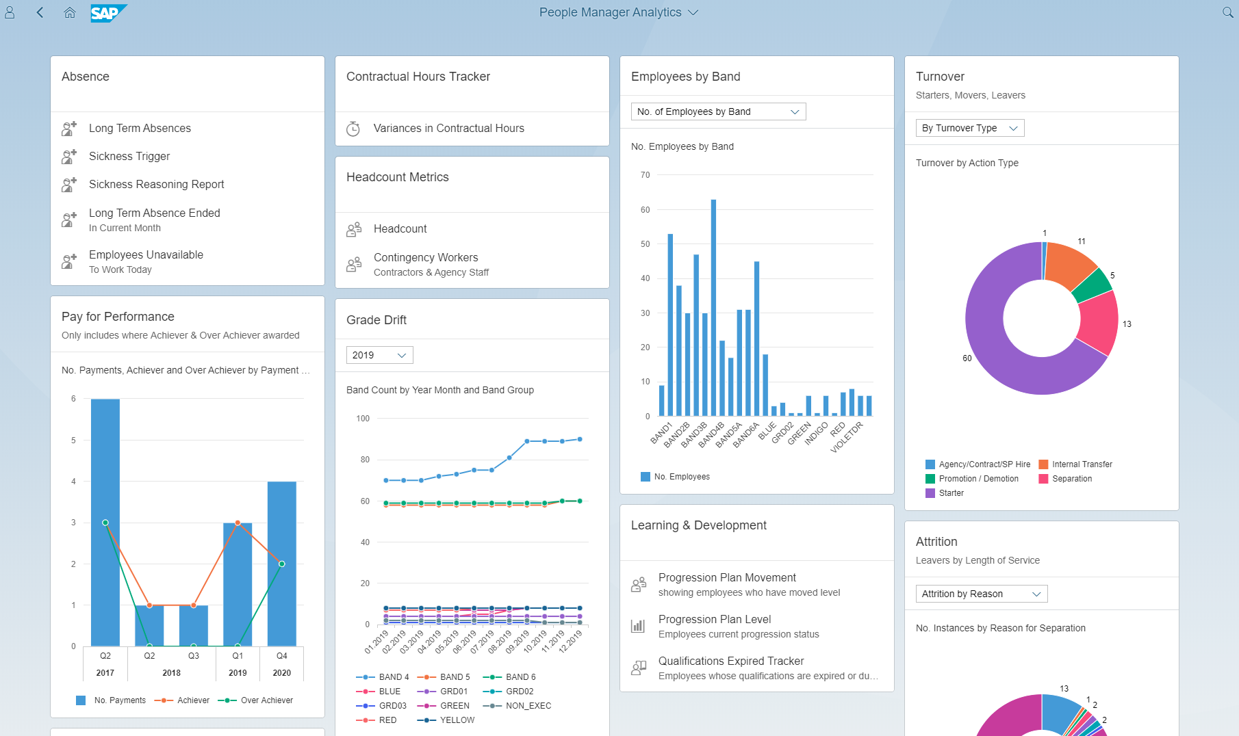
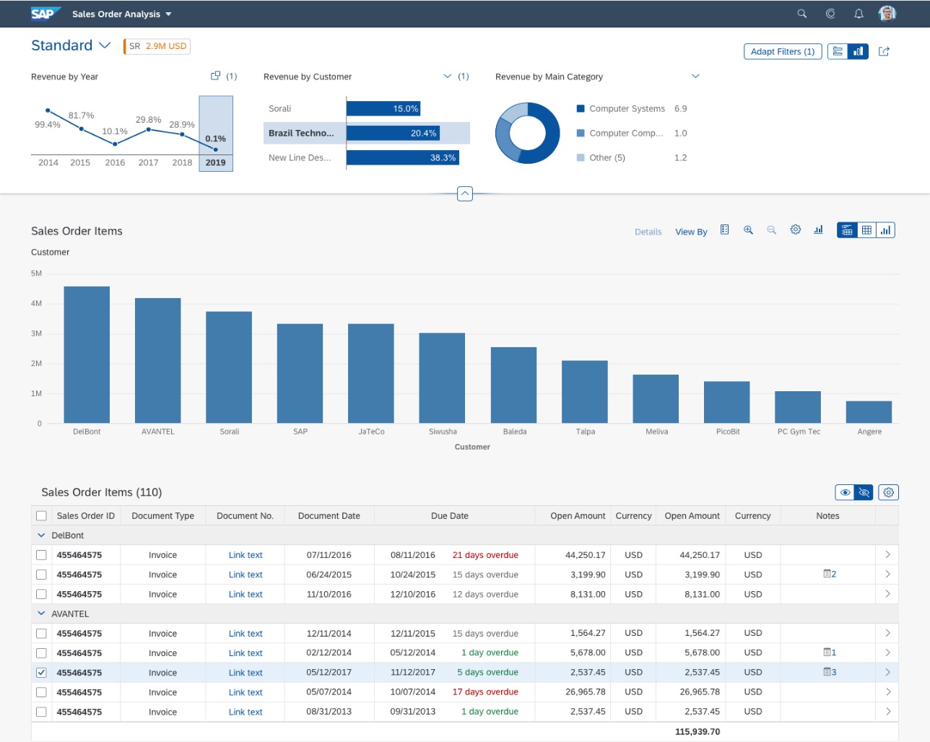
SAP Fiori Element App looks like as:
Trainer: Anubhav Oberoy

Slide 13
Annotation
Annotation files are usually defined as data sources in manifest. Json.
Semantic business layer which independent of UI the layer
In the dataSources definition of the OData service, you can reference these annotation data sources in the annotations setting.
Metadata annotations can be used to define additional characteristics or capabilities of a metadata element, such as a service, entity type, property, function, action or parameter.
The Fiori has standard elements aps like:
1. List Report
2. OVP – Over view pages
3. ALP – Analytic List page
CDS View : Core Data Service in SAP S/4HANA system, is one best way to push down logic to SAP HANA
Documentation Link: https://help.sap.com/viewer/cc0c305d2fab47bd808adcad3ca7ee9d/7.5.9/en-US/f8af07bb0770414bb38a25cae29a12e9.html
Trainer: Anubhav Oberoy

Slide 14
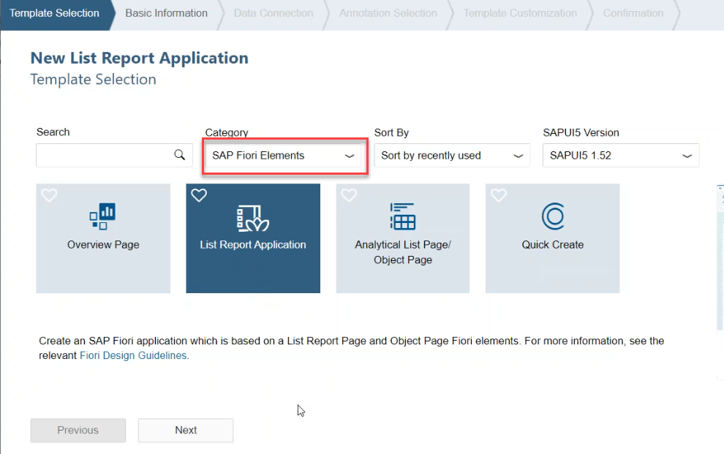
Create a Fiori Element Application
Steps:
Go to WebIDE and Create a new project from template.
Select Category as SAP Fiori Elements
Fill all the required details and Select a particular service name
Trainer: Anubhav Oberoy

Slide 15
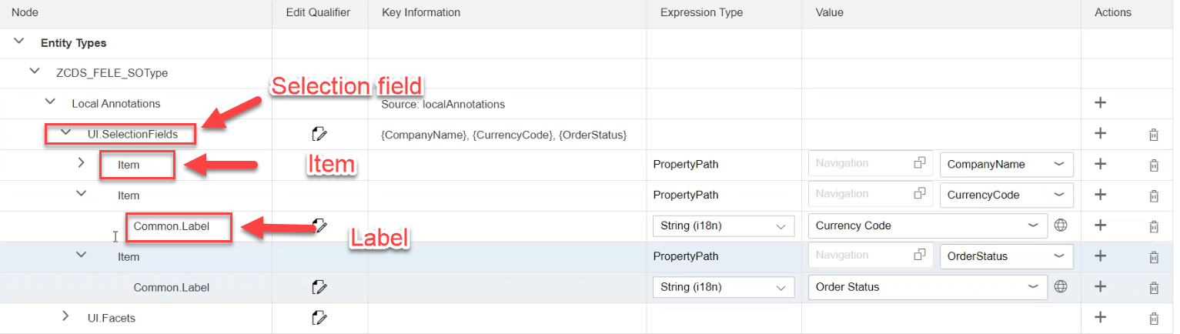
Add Selection field in Fiori Element App:
Go to annotations Folder and open file
Add a Selection field:
Click on + button of Local Annotation and select Selection Field
Click on + of Selection field and choose Item and Fill property path and
Give the label of item using click on + of Item
Trainer: Anubhav Oberoy

Slide 16
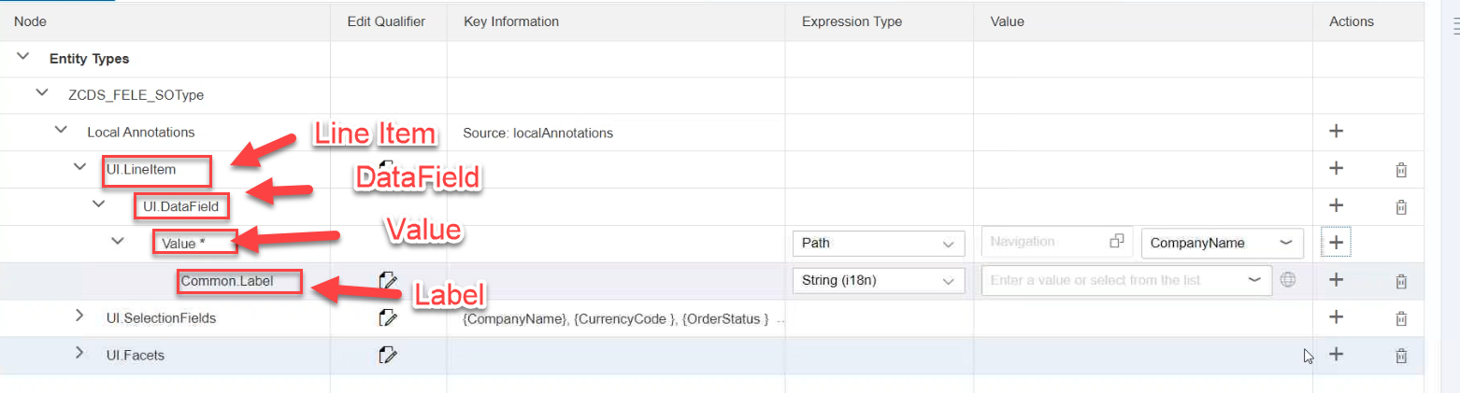
Add LineItem annotations:
Click on + button of Local Annotation and Select LineItem
Add a column in LineItem then click on + of LineItem and Choose DataField
Give label name of data field
Click on + of value and choose label
Trainer: Anubhav Oberoy

Slide 17
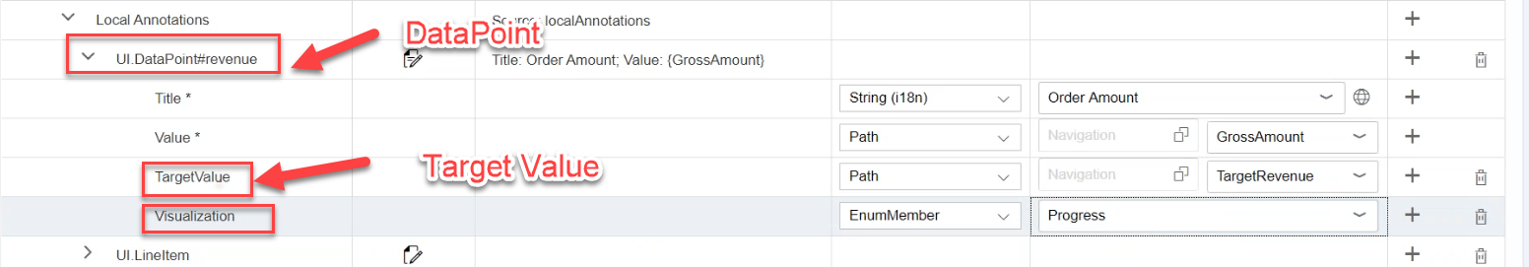
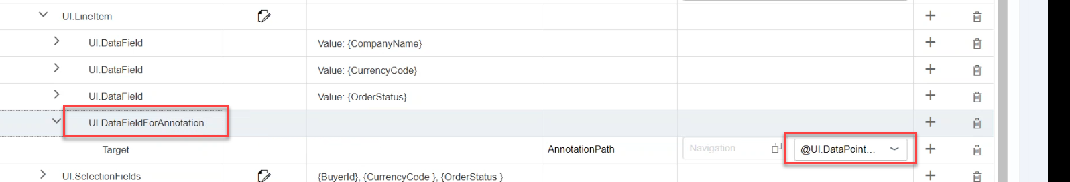
Represent DataPoint
Click on + on Local Annotations and choose DataPoint
Edit name of this field
Click + on DataPoint and choose TargetValue
Show the data:
Click + on DataPoint and Select any Property like Visualization
Trainer: Anubhav Oberoy

Slide 18

End of Day 6

Slide 19

Questions

Slide 20

Anubhav Oberoy

Slide 21


We’re committed to empower you to be
Most Desirable Resource
through powerful training solutions.
We build the workforce of the future.
250+
Corporate Clients
30,000+
Learners Trained
25000+
Learners Placed
FREE WEBINARS
Sign up for free webinars with industry experts every fortnight!
Enroll Now!
Contact us today!
https://anubhavtrainings.com/

Slide 22




More from AnubhavTrainings.com

